Slide 1
Java Design pattern Presenter: Nguyen ho phuong (MS/EET31)

Slide 2
History of patterns
Java Design pattern
Benefit of design pattern
Classification of patterns

Slide 3
History of patterns

Slide 4
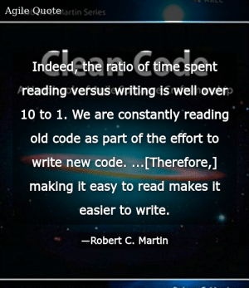
Philosophy
History of patterns

Slide 5
Philosophy
History of patterns
“Any fool can write code that a computer can understand. Good programmers write code that humans can understand.”
– Martin Fowler"

Slide 6

Philosophy
History of patterns

Slide 7

What is design?
History of patterns
A plan or drawing produced to show the look and function or workings of a building, garment, or other object before it is built or made.

Slide 8
What is a GOOD design?
History of patterns
Not only solving current problem
but also solving it in the future
Not only run successful on small system
but also run successful on bigger system
Not only run successful for current version
but also run successful for others

Slide 9
Java design pattern

Slide 10
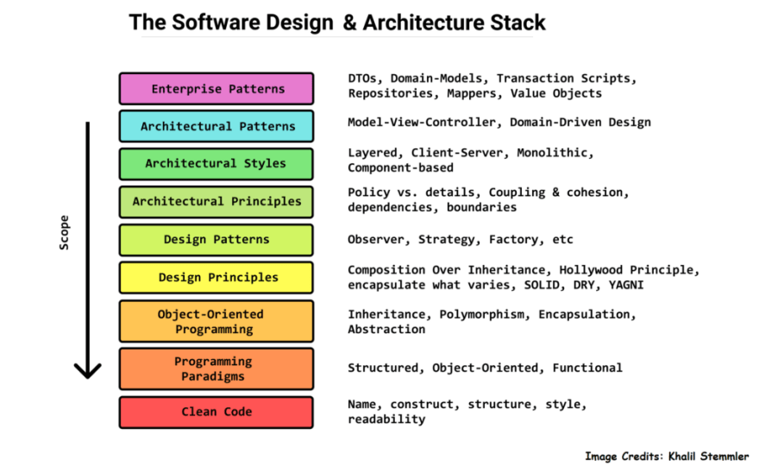
What is design pattern?
Java Design Pattern
Design patterns are typical solutions to commonly occurring problems in software design. They are like pre-made blueprints that you can customize to solve a recurring design problem in your code.

Slide 11
Benefit of Design pattern
Java Design Pattern
Accelerate software design and development
Prevent incurred problems when design is bad
Can be applied for different of situation
Easy to collaborate, sharing source code between each othera

Slide 12
Classification
Java Design Pattern
Creational
How are objects created?
Design pattern
Structural
Behavioral
How are objects interacted?
How are objects constructed?

Slide 13
Classification

Slide 14
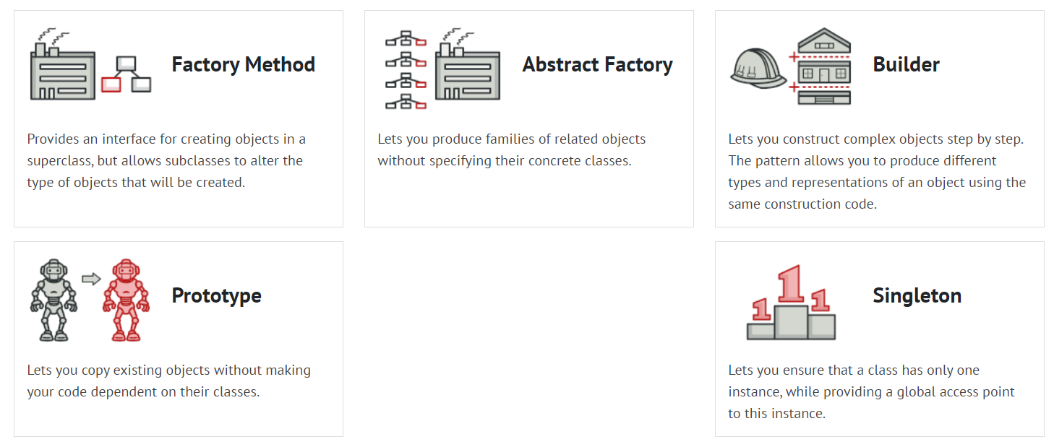
Creational design pattern
Classification
Creational design patterns provide various object creation mechanisms, which increase flexibility and reuse of existing code.

Slide 15


Singleton
Creational Pattern
Intent
Singleton is a creational design pattern that lets you ensure that a class has only one instance, while providing a global access point to this instance.

Slide 16

Singleton
Creational Pattern
Problem
The Singleton pattern solves two problems at the same time, violating the Single Responsibility Principle
Ensure that a class has just a single instance
Why? → Control access to a shared resource, configuration file.
Problem? → Accidentally calling constructor instead of getting existing one.
Provide a globally access point to that instance
Why? → Just like a global variable, the Singleton pattern lets you access some object from anywhere in the program
Problem? → Multi-threading might be unsafe since any code can potentially overwrite the contents

Slide 17

Singleton
Creational Pattern
Solution
Make a default private constructor, to prevent other objects from using new operation
Create a static creation method acts as a constructor
Call private constructor to create an object and save it to a static field
Return that cached static field when for all subsequence call

Slide 18
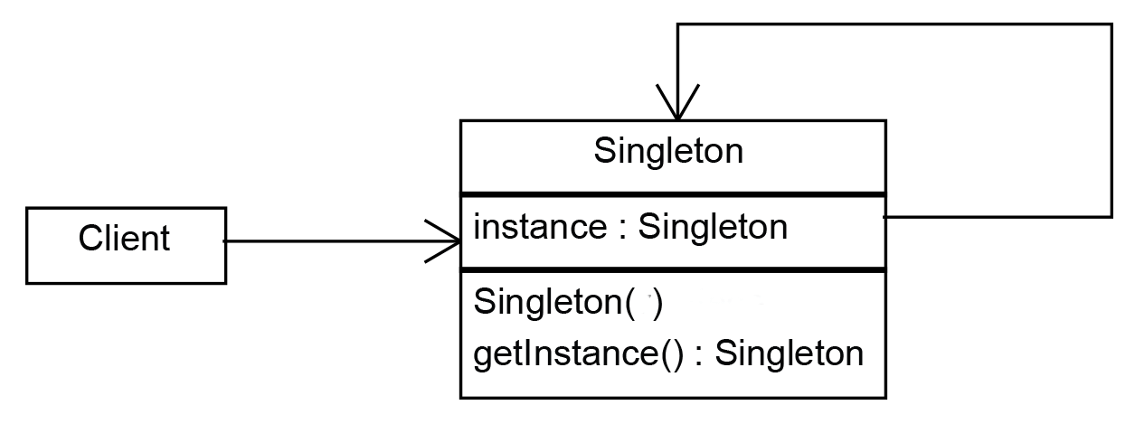
Diagram
Creational Pattern
Example:
Spring Beans with singleton scope

Slide 19
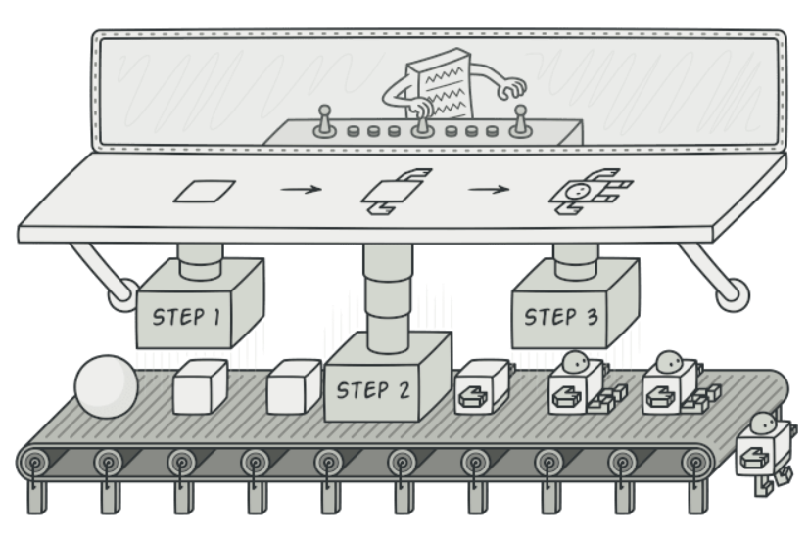
Builder
Creational Pattern
Intent
Builder is a creational design pattern that lets you construct complex objects step by step. The pattern allows you to produce different types and representations of an object using the same construction code

Slide 20
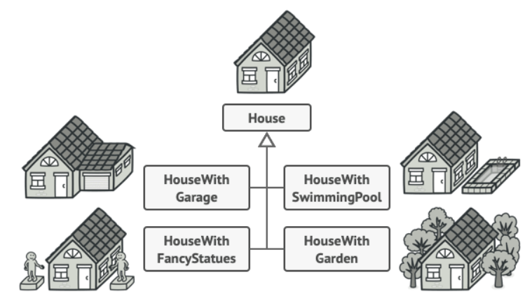
Builder
Creational Pattern
Problem
To meet the requirement, create a parent class called House, then create subclass extend from class House with other features. i.e: class HouseWithGarage, class HouseWithGarden
Create a single class with massive constructor argument
new House(windows, door, room, null, null…);

Slide 21
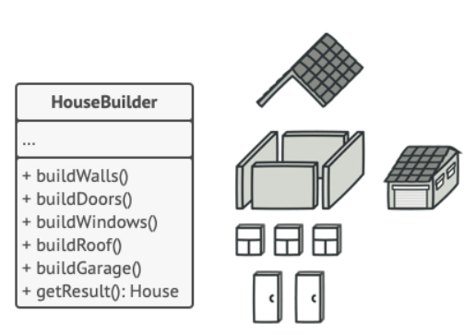
Builder
Creational Pattern
Solution
Make a default private constructor, to prevent other objects from using new operation
Create a static creation method acts as a constructor
Call private constructor to create an object and save it to a static field
Return that cached static field when for all subsequence call

Slide 22
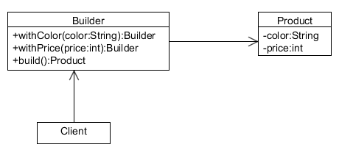
Builder
Creational Pattern
Example:
java.lang.StringBuilder
java.lang.StringBuffer
javax.ws.rs.core.URIBuilder

Slide 23
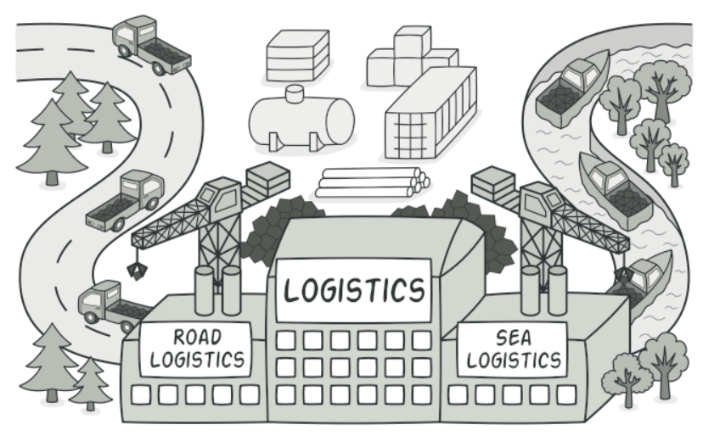
Factory
Creational Pattern
Intent
Factory Method is a creational design pattern that provides an interface for creating objects in a superclass, but allows subclasses to alter the type of objects that will be created.

Slide 24
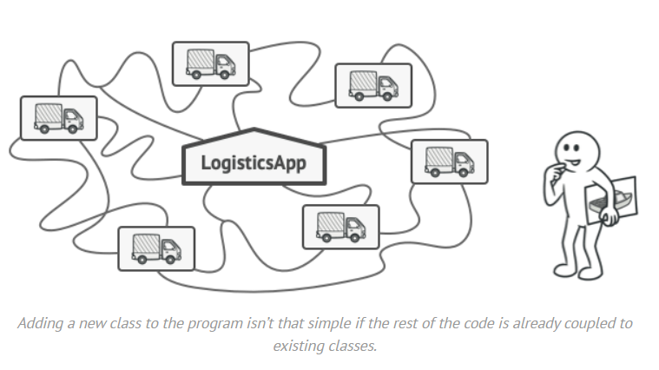
Factory
Creational Pattern
Problem
Code base is coupled to the Truck class, how to add Ship class to it?

Slide 25
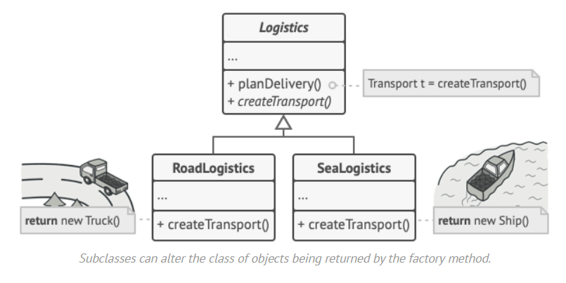
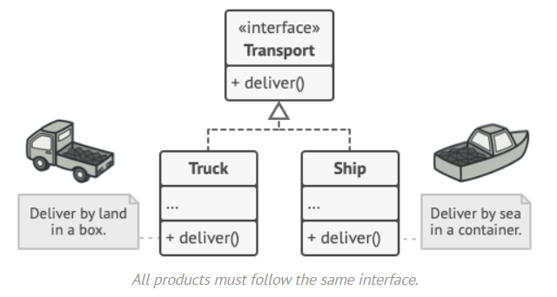
Factory
Creational Pattern
Solution

Slide 26
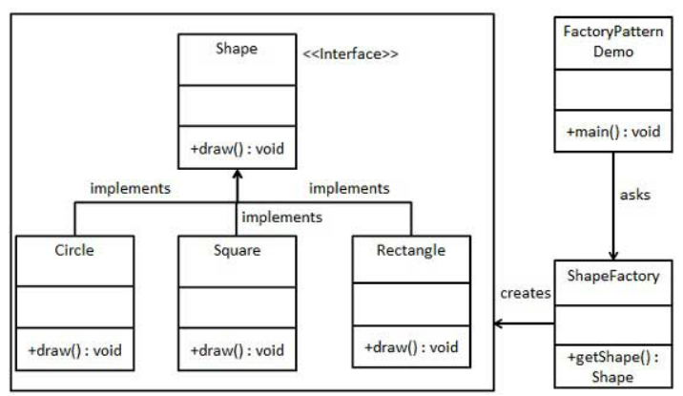
Factory
Creational Pattern
Example:
java.sql.DriverManager#getConnection()
org.apache.poi.ss.usermodel.WorkbookFactory.createWorkbook();

Slide 27
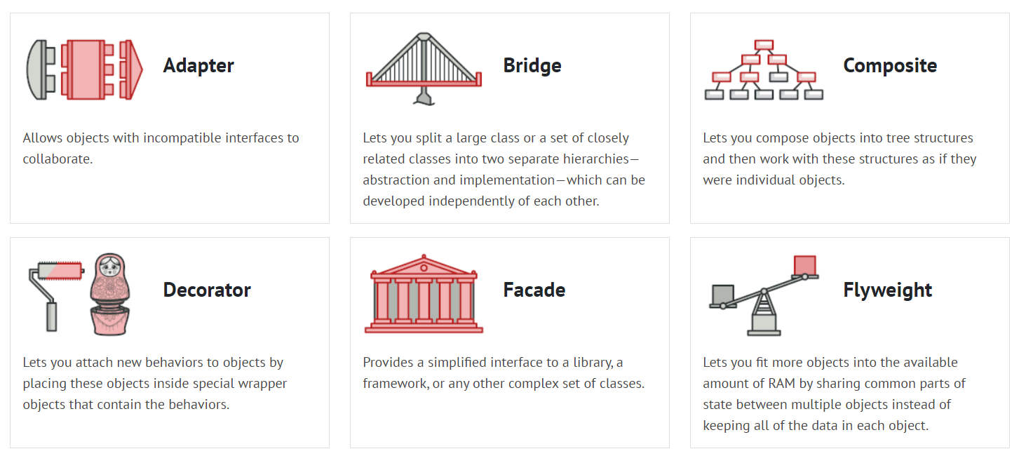
Structural pattern
Classification
Structural design patterns explain how to assemble objects and classes into larger structures, while keeping these structures flexible and efficient.

Slide 28
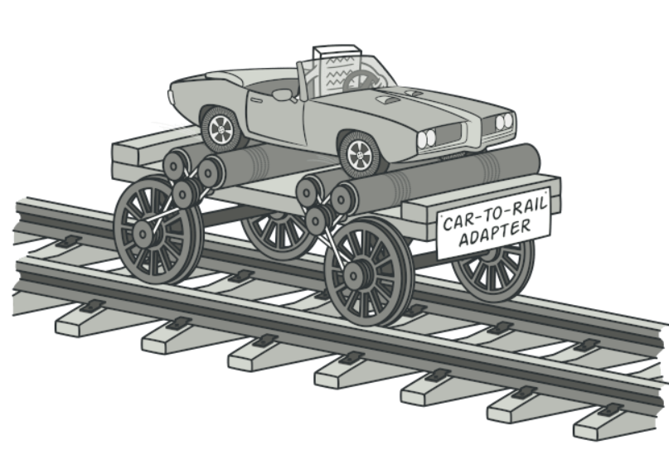
Adapter
Structural Pattern
Intent
Adapter The adapter pattern is a structural design pattern used to allow two incompatible interfaces to work together. It involves creating a wrapper class that converts one interface into another.

Slide 29
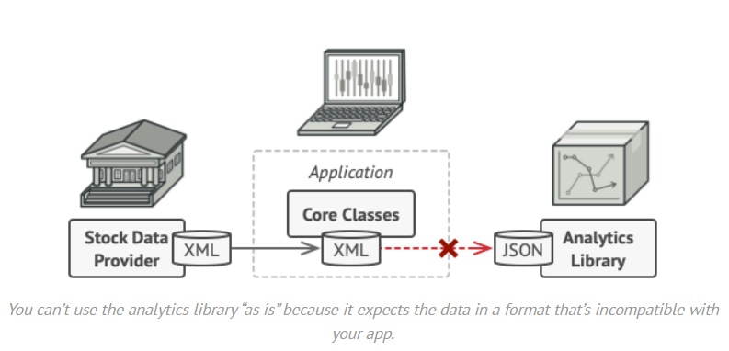
Adapter
Structural Pattern
Problem
Data format incompatible. How to deal with it?

Slide 30
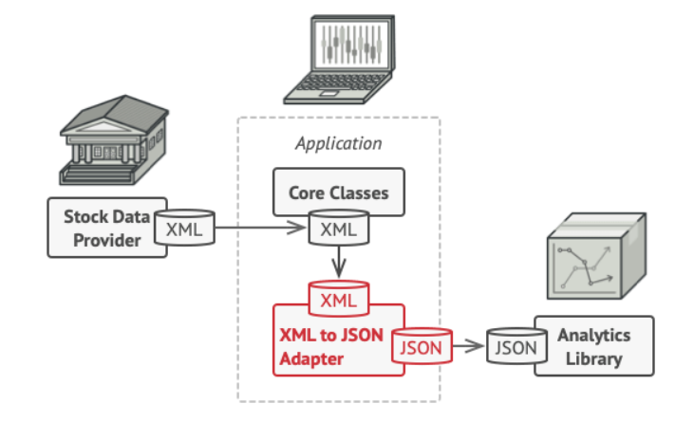
Adapter
Structural Pattern
Solution
Create an adapter which is a special object that converts the interface of one object so that another object can understand it.

Slide 31
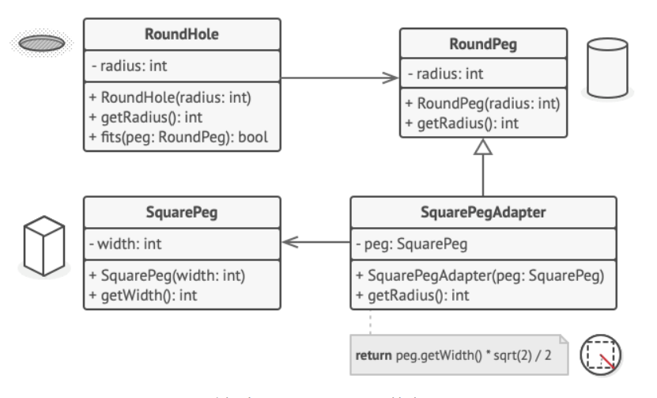
Adapter
Structural Pattern
Example:
Arrays.asList(…);

Slide 32
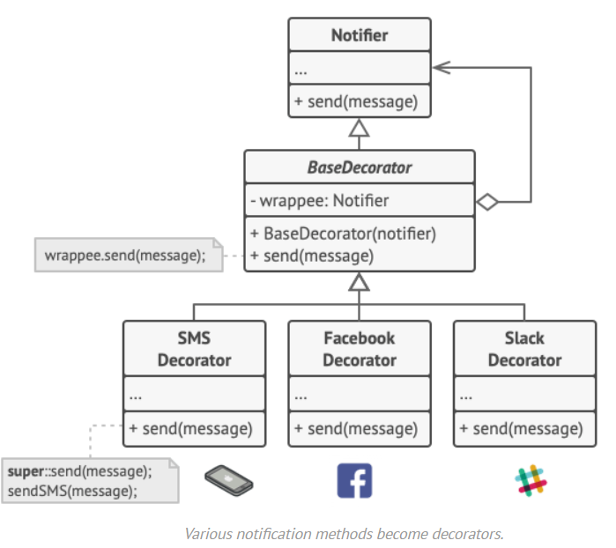
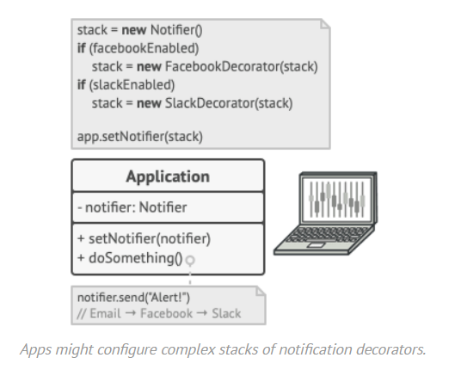
Adapter
Structural Pattern

Slide 33
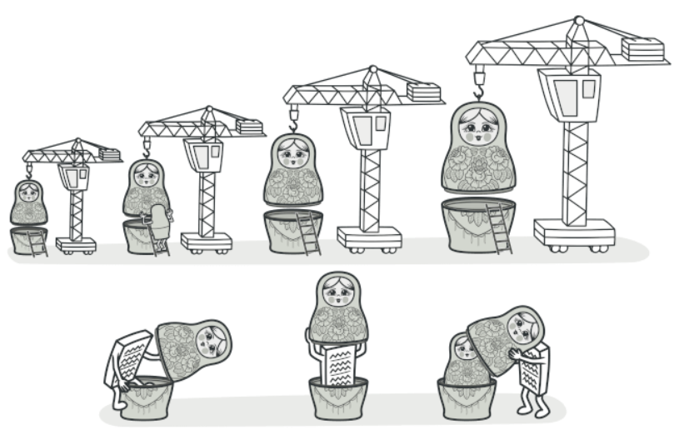
Decorator
Structural Pattern
Intent
Decorator is a structural design pattern that lets you attach new behaviors to objects by placing these objects inside special wrapper objects that contain the behaviors.

Slide 34
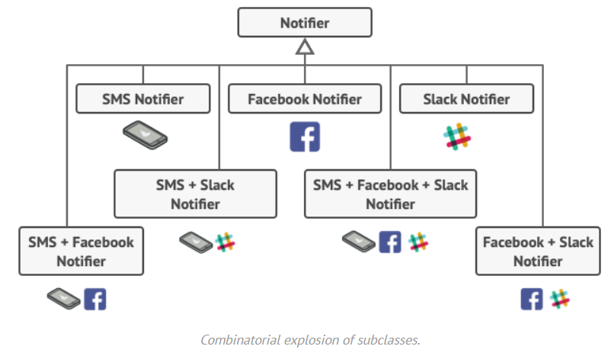
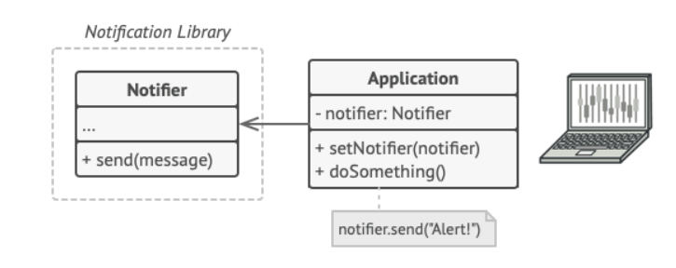
Decorator
Structural Pattern
Problem
Combinatorial explosion of subclasses? What a headache.

Slide 35
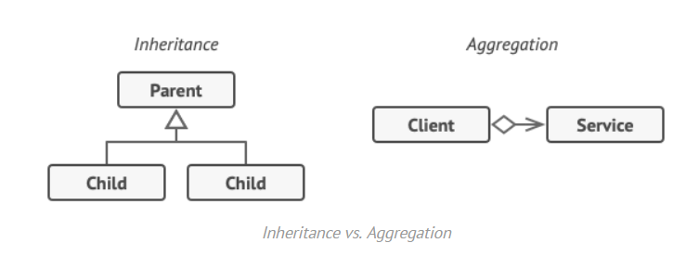
Decorator
Structural Pattern
Solution
Instead of using Inheritance, we should use Aggregation(*) or Composition(**).
One object has reference to another and delegates it some works, whereas with inheritance, the object itself has to do that work.
Easily substitute the linked “helper” with others
The “wrapper” implements the same interface as the wrapped object → Client think they’re identical.
(*) object A contains objects B; B can live without A.
(**) object A consists of objects B; A manages life cycle of B; B can’t live without A.

Slide 36
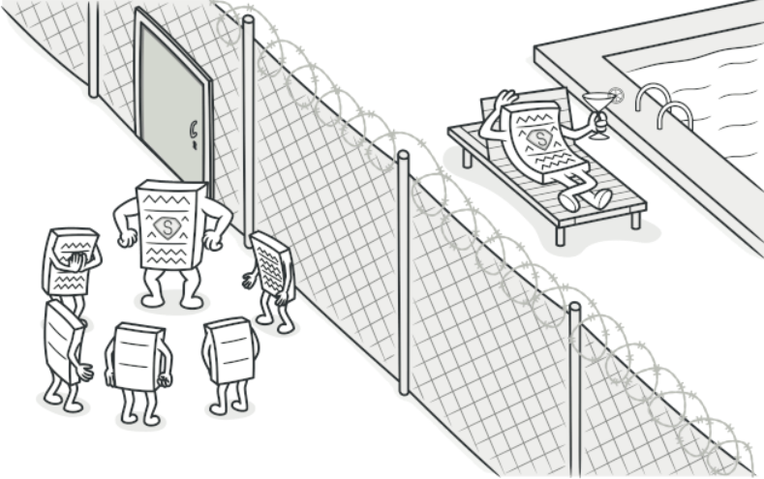
Proxy
Structural Pattern
Intent
Proxy is a structural design pattern that lets you provide a substitute or placeholder for another object. A proxy controls access to the original object, allowing you to perform something either before or after the request gets through to the original object.

Slide 37
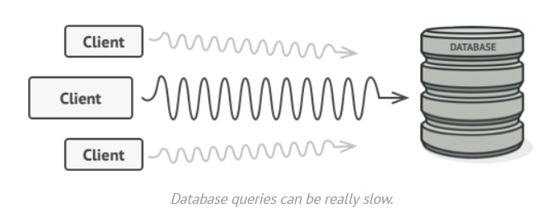
Proxy
Structural Pattern
Problem
Combinatorial explosion of subclasses? What a headache.

Slide 38
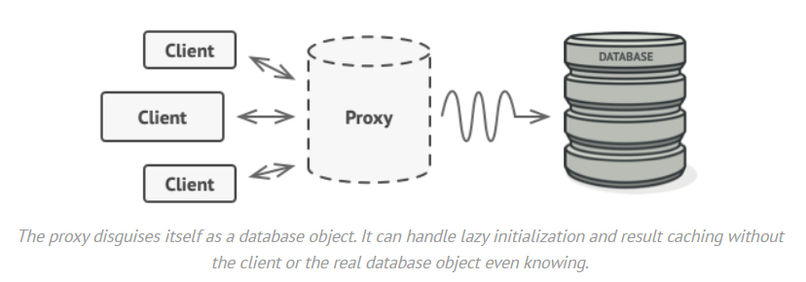
Proxy
Structural Pattern
Solution
Create a proxy with same interface as an original service object
Proxy will delegate most of the works to original object
Proxy can do some stuff before delegating in order to the reduce the workload of original object.

Slide 39
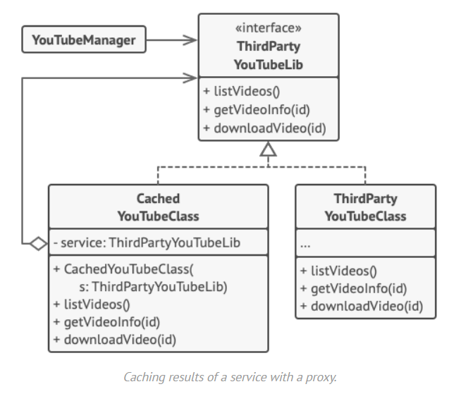
Proxy
Structural Pattern

Slide 40
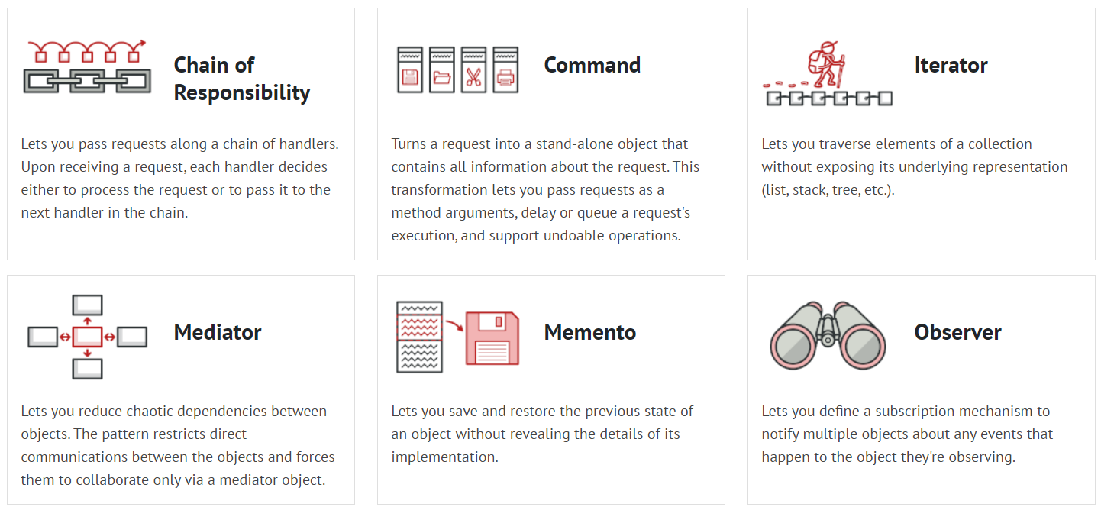
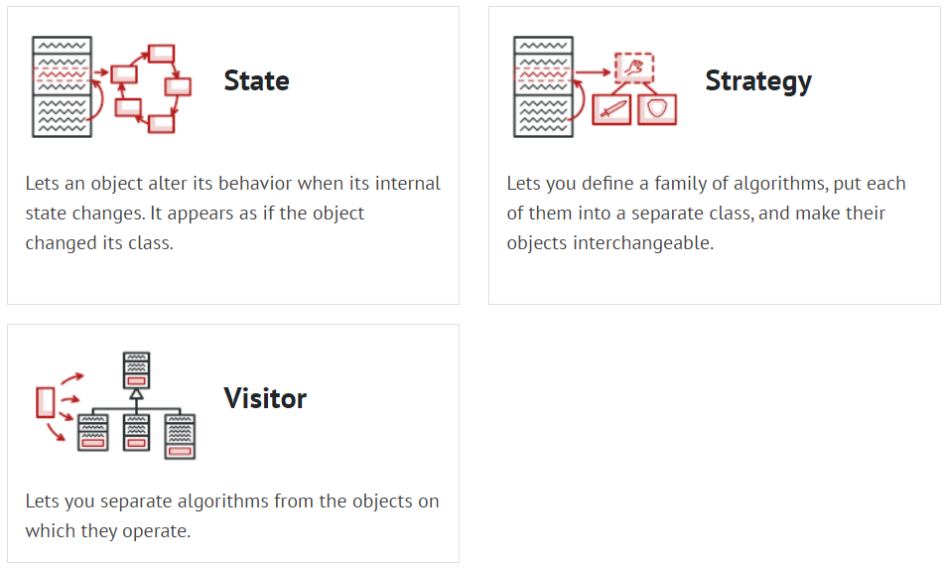
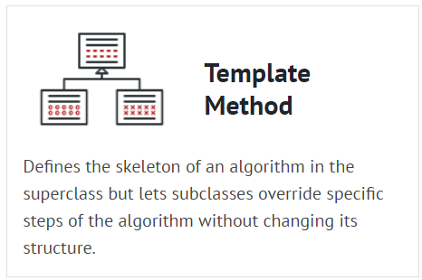
Behavioral pattern
Classification
Behavioral design patterns are concerned with algorithms and the assignment of responsibilities between objects.

Slide 41
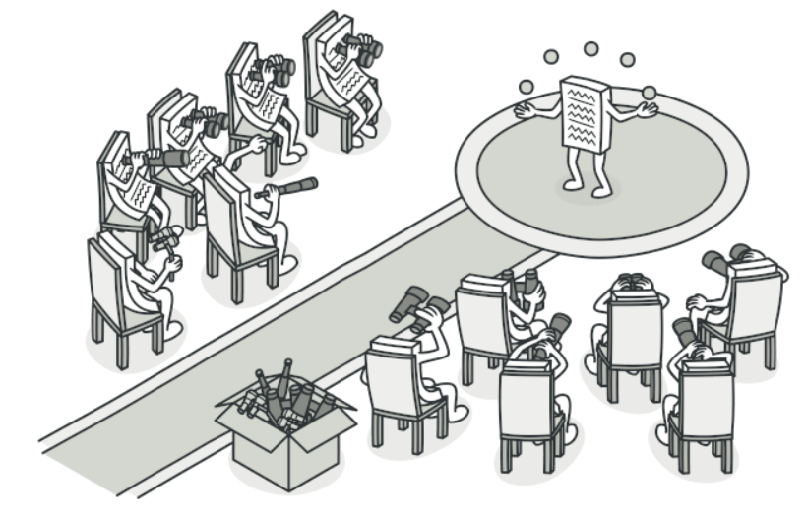
Observer
Behavioral Pattern
Intent
Observer is a behavioral design pattern that lets you define a subscription mechanism to notify multiple objects about any events that happen to the object they’re observing.

Slide 42
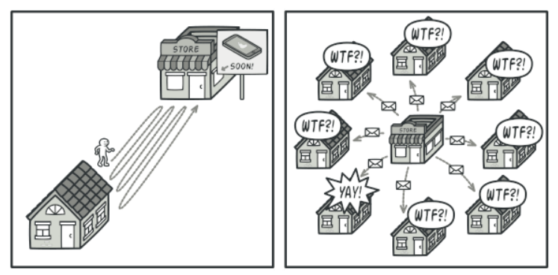
Observer
Behavioral Pattern
Problem
Why do we need to repeatedly check for new model? Let’s they notify us but…

Slide 43
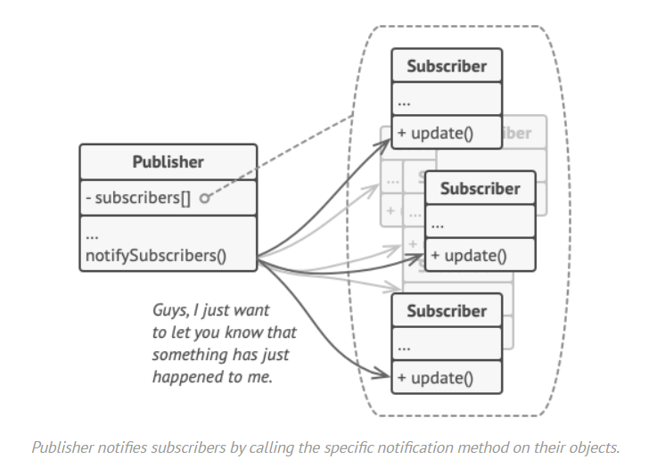
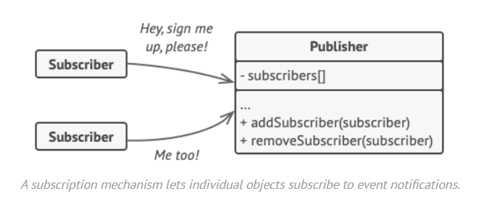
Observer
Behavioral Pattern
Solution

Slide 44
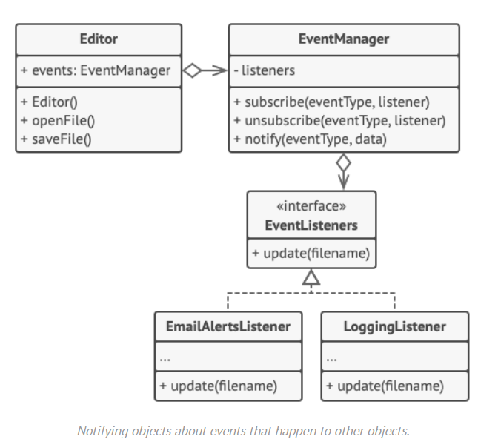
Observer
Behavioral Pattern

Slide 45
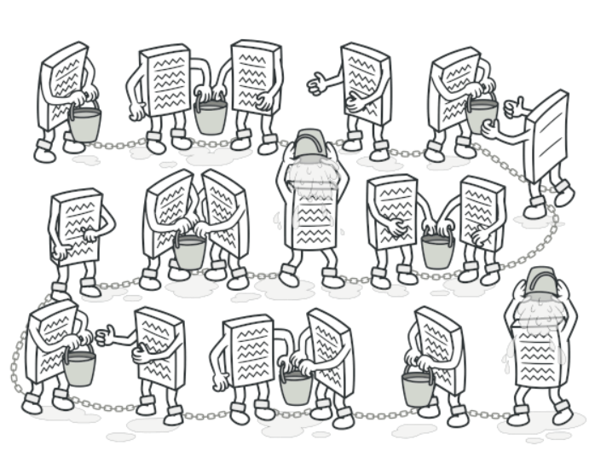
Chain of responsibility
Behavioral Pattern
Intent
Chain of Responsibility is a behavioral design pattern that lets you pass requests along a chain of handlers. Upon receiving a request, each handler decides either to process the request or to pass it to the next handler in the chain.

Slide 46
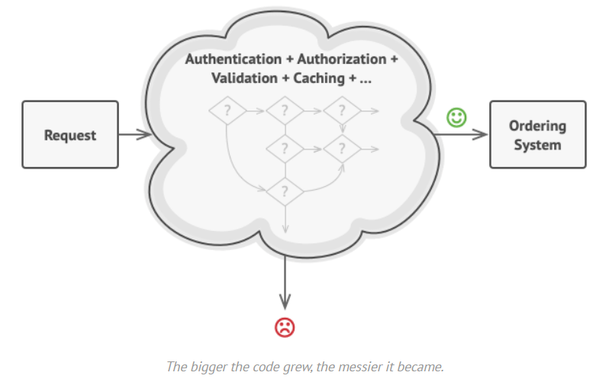
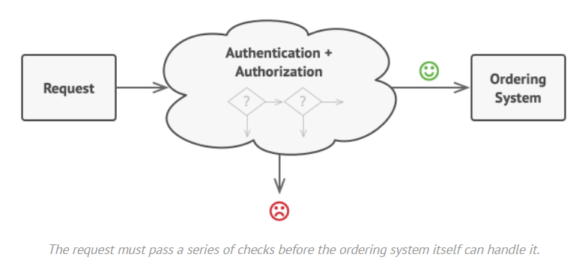
Chain of responsibility
Behavioral Pattern
Problem
After some new feature, your code will become a mess.

Slide 47
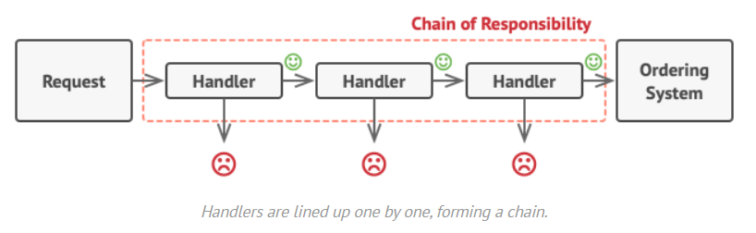
Chain of responsibility
Behavioral Pattern
Solution
Split up to individual responsibility
These handlers can be reuse in other places

Slide 48
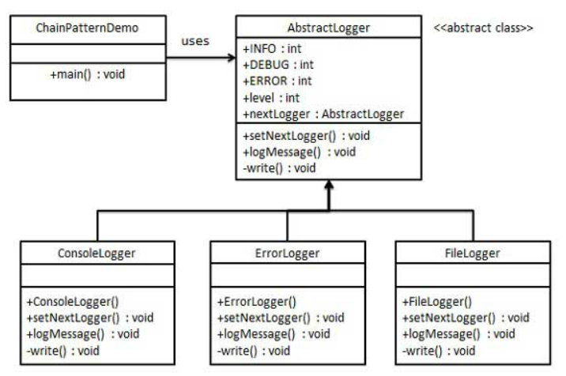
Chain of responsibility
Behavioral Pattern

Slide 49
Thank you for your listening ☺

Slide 50
Reference
Design pattern
https://sourcemaking.com/design_patterns/factory_method
https://refactoring.guru/design-patterns/
https://www.tutorialspoint.com/design_pattern/

